Slide 1
E-retail factors for customer activation and retention
Aaron D'souza

Slide 2
Agenda / Topics
Problem Definition
Data Analysis
EDA (Exploratory Data Analysis)
Concluding Remarks

Slide 3
Problem Definition
Customer satisfaction has emerged as one of the most important factors that guarantee the success of online store. It has been posited as a key stimulant of purchase, repurchase intentions and customer loyalty.
Five major factors that contributed to the success of an e-commerce store have been identified as: service quality, system quality, information quality, trust and net benefit.
Large number of customers are getting attracted towards online retailing; this is because e-stores usually offer them a variety of services and products according to their preferences.
The research furthermore investigated the factors that influence the online customers repeat purchase intention on the basis of the Means End Chain theory (MEC) and Prospect theory.

Slide 4
Data Analysis
Convenience, round the clock availability, flexible pricing, discounts as well as free door step delivery are some of the major benefits of shopping online.
As an aspiring Data Scientist the goal is to apply my analytical skills to give findings and conclusions in detailed data analysis written in jupyter notebook.
This analysis will then be used by the E-commerce retailers to understand how exactly the variables are related to each other and what factors should be improved in order to attain high customer loyalty.

Slide 5
Data Analysis
The sample data is provided to us from our client database.
A total of two data types in the data set Int and Object.
The data provided was well organized structured data in .CSV (comma-separated values) format.
The data set has a total of 70 columns.

Slide 6
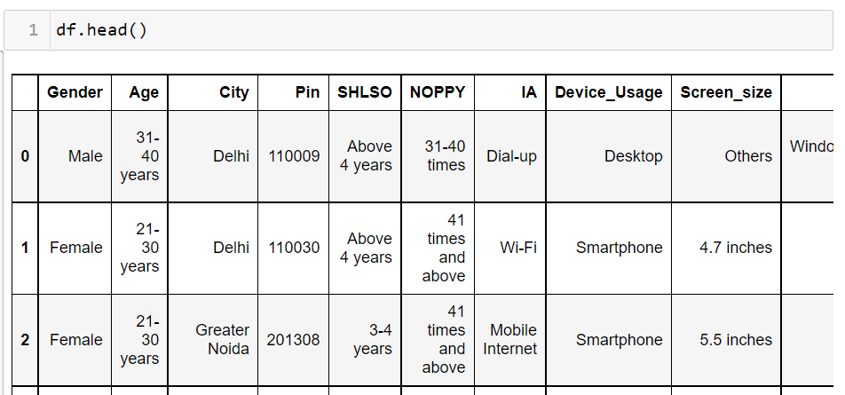
Data Analysis: Data frame sample

Slide 7
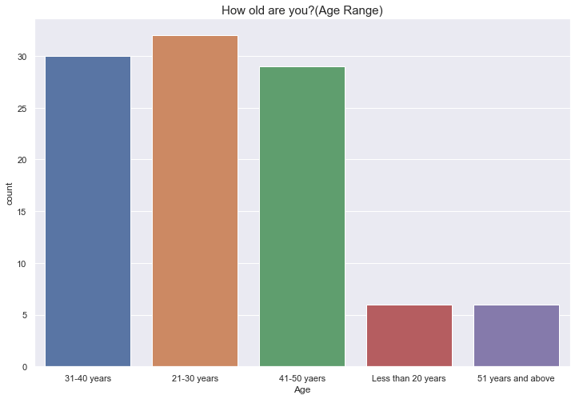
EDA (Exploratory Data Analysis)
The visualization in Fig.2 is a count plot from sea-born library it shows the distribution of Customer Age. Most of the customers are within the Age range (21 – 50) years. Less customers from age group below 20 years and above 51 years.
Fig.2

Slide 8
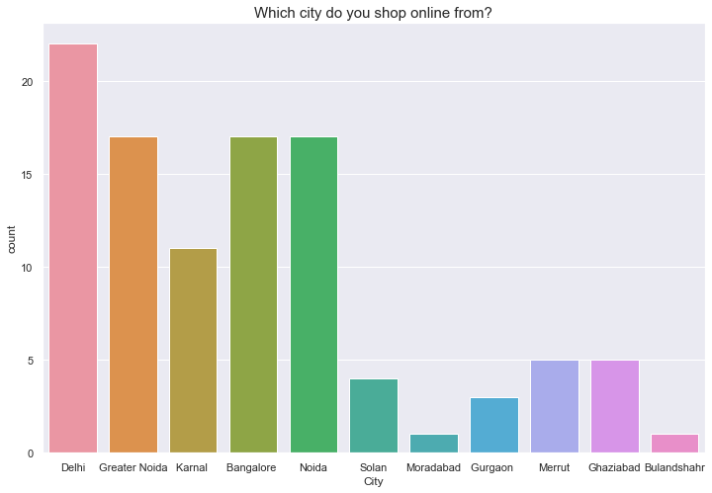
EDA (Exploratory Data Analysis)
The visualization in Fig.3 is a count plot from sea-born library it shows the distribution of Cities the customers originate from. Delhi has the highest number of customers who are involved in online shopping (Important customers for the e-commerce company) followed by Greater Noida, Bangalore, and Noida.Moradabad, Bulandshahr have very few customers (the Ecom companies should investigate and find out the reasons for customers being less in those areas) and try to enhance sales in those areas.
Fig.3

Slide 9
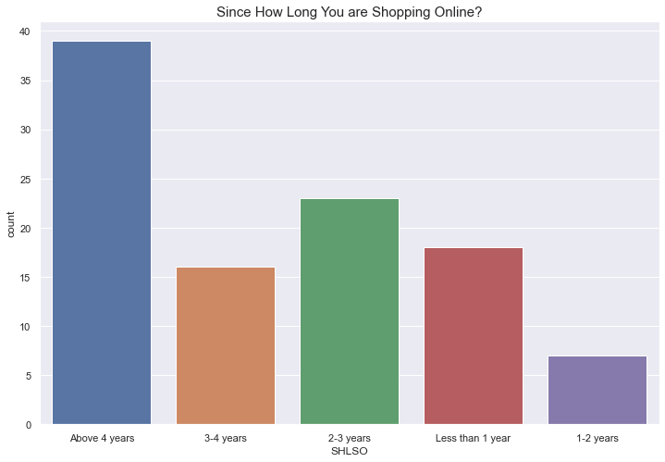
EDA (Exploratory Data Analysis)
The visualization in Fig.4 is a count plot from sea-born library it shows the distribution for how long a customer is been shopping for. Most of the regular customers have been shopping for more than 4 years(Important customers, loyal customers). Need to provide best services to customers who have recently been shopping for less than 1 year (better the service more the loyalty).
Fig.4

Slide 10
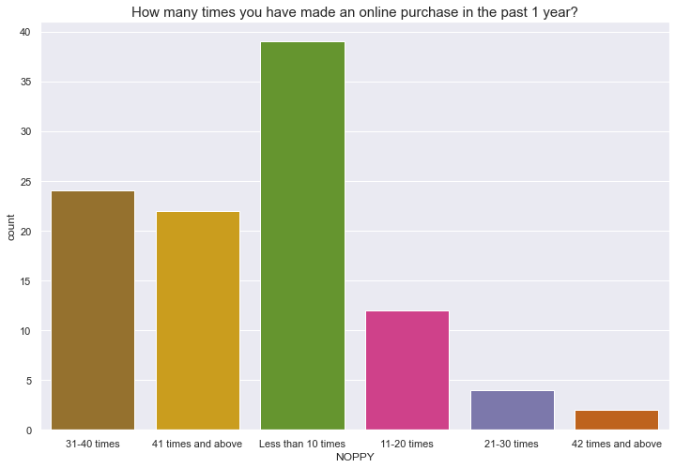
EDA (Exploratory Data Analysis)
The visualization in Fig.5 is a count plot from sea-born library it shows the distribution for how many times a customer has made an online purchase in the past 1 year. Less than 10 times is the highest count for the customers who have purchased something online in the past 1 year(maybe average customers).41 times and 42 times and above are important customers to the e-commerce company (Customers who have a high engagement rate in online purchases). Mostly an average customer is buying ~ 10 items yearly.
Fig.5

Slide 11
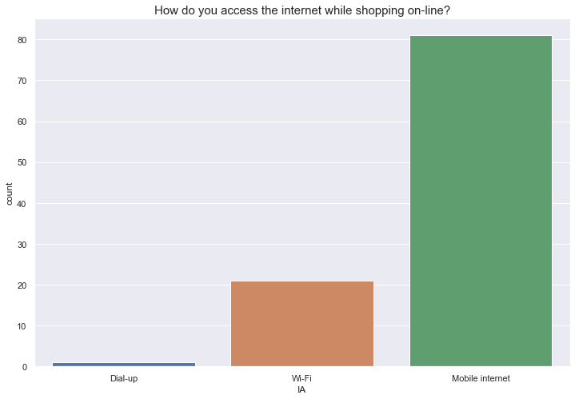
EDA (Exploratory Data Analysis)
The visualization in Fig.6 is a count plot from sea-born library it shows the distribution for how a customer access internet for online shopping. Most of the customers are using mobile data(Internet) while shopping online.
Fig.6

Slide 12
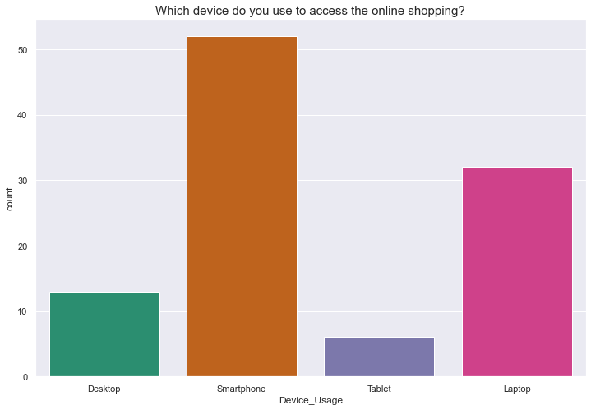
EDA (Exploratory Data Analysis)
The visualization in Fig.7 is a count plot from sea-born library it shows the distribution of device usage by customers for online shopping. Laptops and smartphones are the most used devices for online shopping. Tablet's are the least used devices.
Fig.7

Slide 13
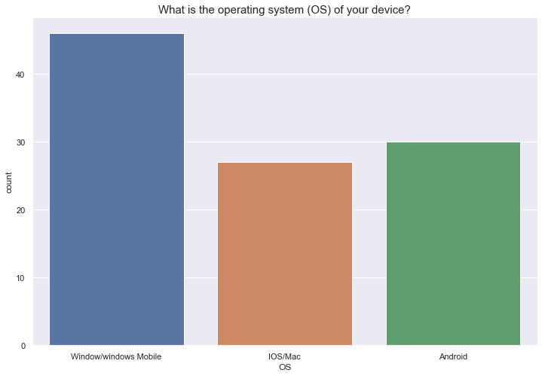
EDA (Exploratory Data Analysis)
The visualization in Fig.8 is a count plot from sea-born library it shows the distribution of which OS users prefer for online shopping. Most of the customers are using Window's operating system on their devices.
Fig.8

Slide 14
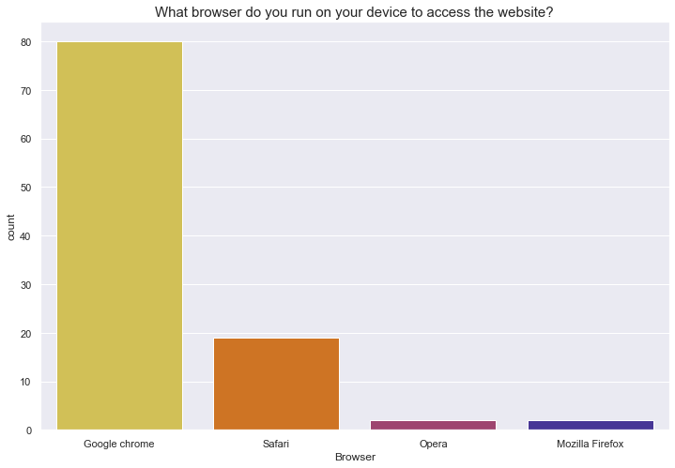
EDA (Exploratory Data Analysis)
The visualization in Fig.9 is a count plot from sea-born library it shows the distribution of which OS users prefer for online shopping. Most of the customers prefer using Google Chrome as their default browser for online shopping.
Fig.9

Slide 15
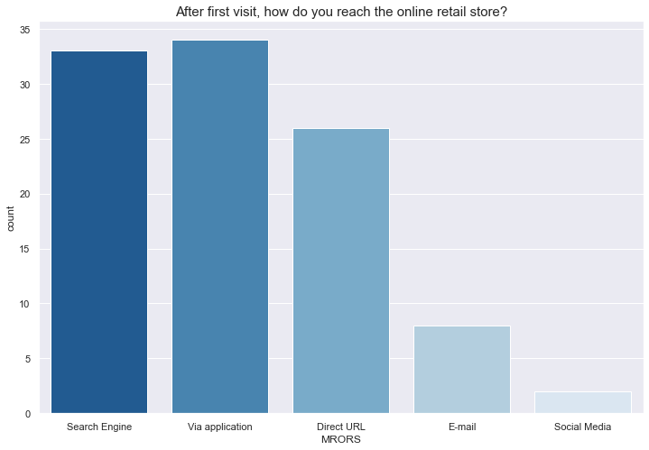
EDA (Exploratory Data Analysis)
The visualization in Fig.10 is a count plot from sea-born library it shows the distribution regarding how customers reached the online store after first visit. After the first visit, most of the individuals prefer to use the Application (mobile app) of the online store or used the Search Engine channel to reach the online store. Social media had very less influence (Companies can work on their social media marketing).
Fig.10

Slide 16
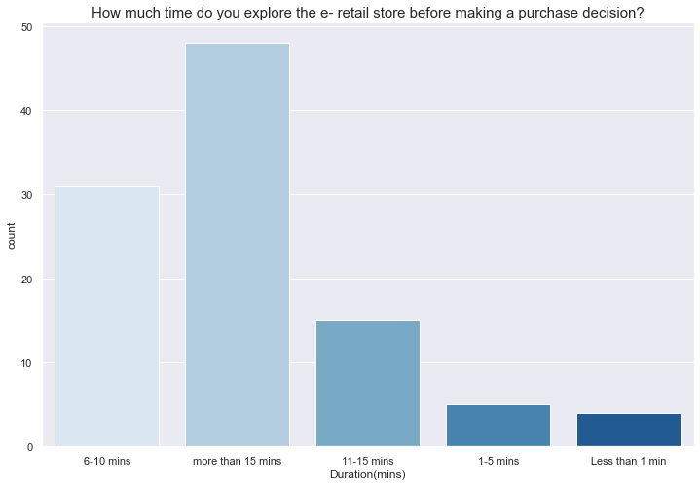
EDA (Exploratory Data Analysis)
The visualization in Fig.11 is a count plot from the sea-born library it shows the distribution for how much time a customer explored the website before making any kind of purchase. On average an individual spent more than 15 minutes on the website before making a purchase decision.
Fig.11

Slide 17
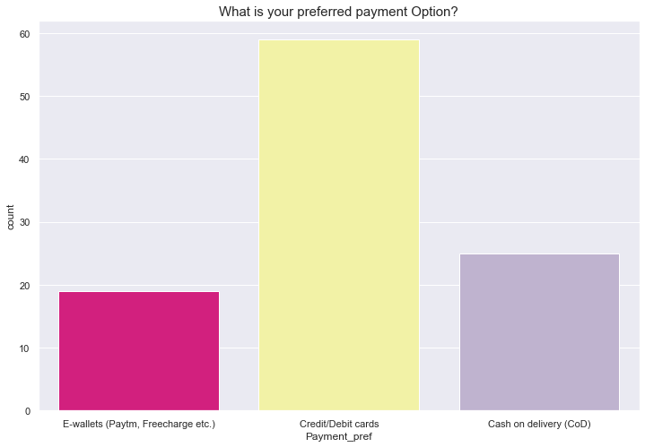
EDA (Exploratory Data Analysis)
The visualization in Fig.12 is a count plot from the sea-born library it shows the distribution of payment preference of customers. Most of the customers preferred a Credit/Debit cards as their payment method. Very few customers preferred E-wallets (Paytm, Freecharge, etc.)
Fig.12

Slide 18
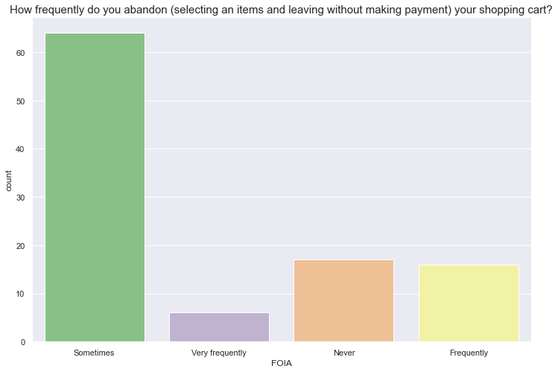
EDA (Exploratory Data Analysis)
The visualization in Fig.13 is a count plot from the sea-born library it shows the distribution of how frequently do customers abandon (selecting an items and leaving without making payment).When it comes to adding an item to the cart but not buying it, most of the customers tend to do it "sometimes" (Due to various personal reasons).
Fig.13

Slide 19
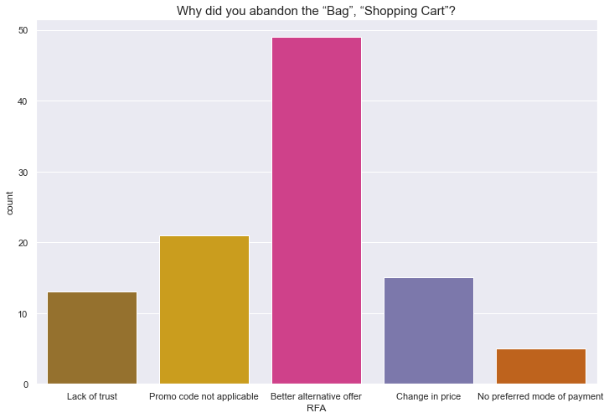
EDA (Exploratory Data Analysis)
The visualization in Fig.14 is a count plot from the sea-born library it shows the distribution of why did a customer abandon the “Bag”, “Shopping Cart”.The most frequent reason for customers not buying the added item in the cart is having a better alternative offer on the same product.
Fig.14

Slide 20
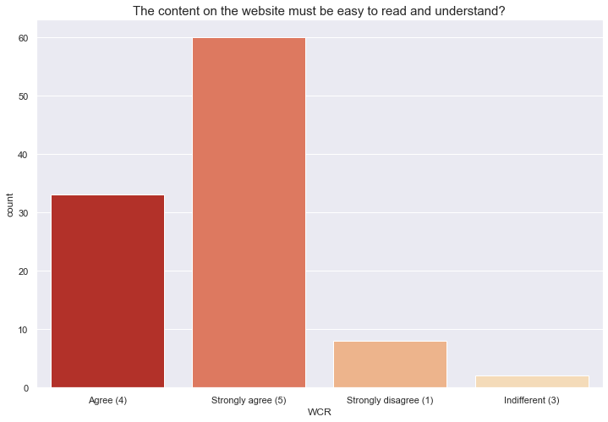
EDA (Exploratory Data Analysis)
The visualization in Fig.15 is a count plot from the sea-born library it shows the distribution is regarding customer response on weather the content on the website must be easy to read and understand. It is very important that the content on the website must be easy to read and understand.
Fig.15

Slide 21
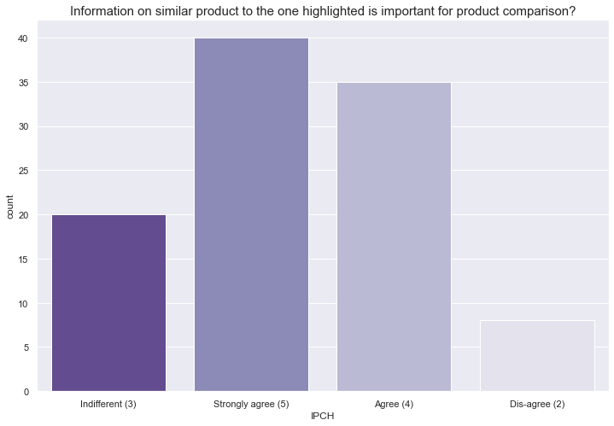
EDA (Exploratory Data Analysis)
The visualization in Fig.16 is a count plot from the sea-born library it clearly concludes that product comparison is a must and is an important factor as the customer will always try to buy what suits best for his needs. Suggesting similar products should be imminent.
Fig.16

Slide 22
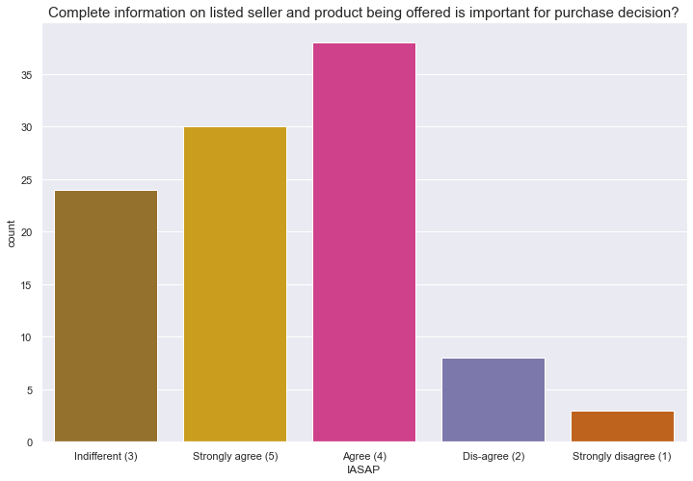
EDA (Exploratory Data Analysis)
The visualization in Fig.17 is a count plot from the sea-born library it clearly concludes that most of the customers agree with providing complete information on the listed sellers and products being offered as it gives them extra assurance in case something went wrong with the product.
Fig.17

Slide 23
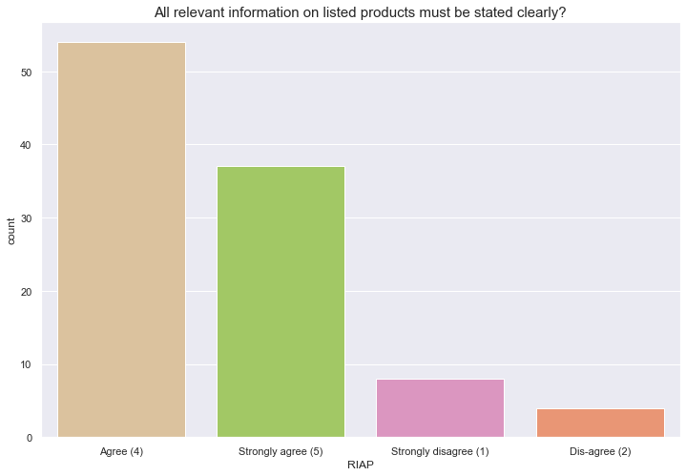
EDA (Exploratory Data Analysis)
The visualization in Fig.18 is a count plot from the sea-born library it clearly concludes that It is very important that the product information(specifications) should be accurate and authentic.
Fig.18

Slide 24
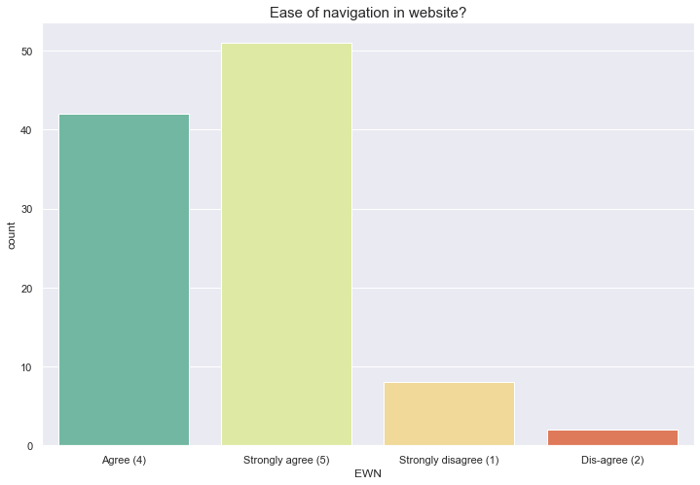
EDA (Exploratory Data Analysis)
The visualization in Fig.19 is a count plot from the sea-born library it clearly concludes that The websites for online stores must be simple to navigate. New users must not have any difficulty while shopping.
Fig.19

Slide 25
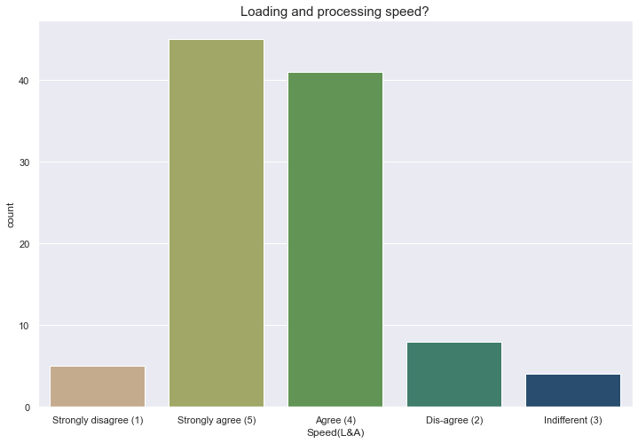
EDA (Exploratory Data Analysis)
The visualization in Fig.20 is a count plot from the sea-born library it clearly concludes that It is very important for customers that the loading speed for their favorite online store should be adequate.
Fig.20

Slide 26
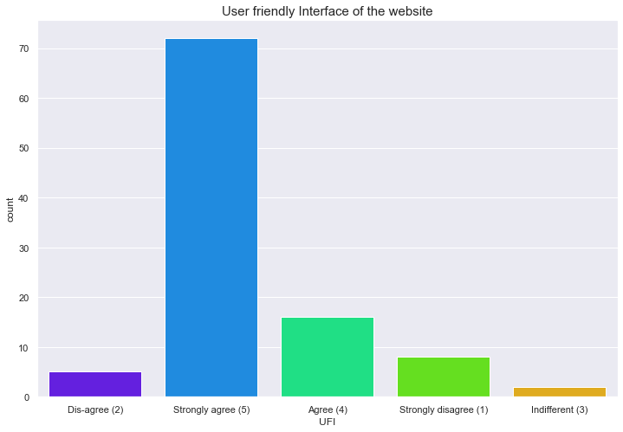
EDA (Exploratory Data Analysis)
The visualization in Fig.21 is a count plot from the sea-born library it clearly concludes that from the user's perspective, a user-friendly UI(user interface) is very important.
Fig.21

Slide 27
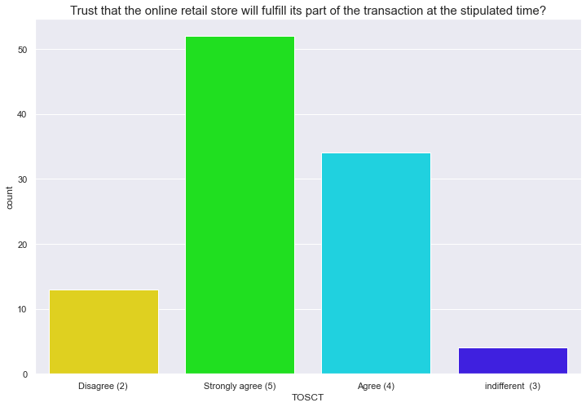
EDA (Exploratory Data Analysis)
The visualization in Fig.22 is a count plot from the sea-born library it clearly concludes that, probably the most important factor for users in terms of payment. The payment should be completed in a time span as it will increase the trustworthiness of customers.
Fig.22

Slide 28
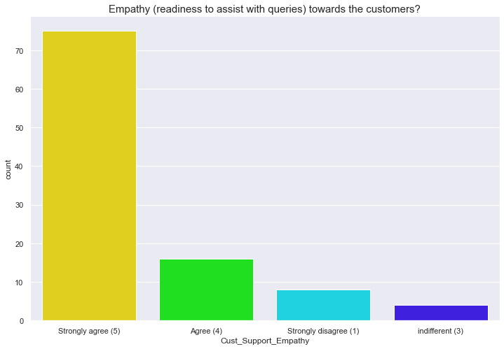
EDA (Exploratory Data Analysis)
The visualization in Fig.23 is a count plot from the sea-born library it clearly concludes that, customer support is a crucial factor to improve customer loyalty and trust.
Fig.23

Slide 29
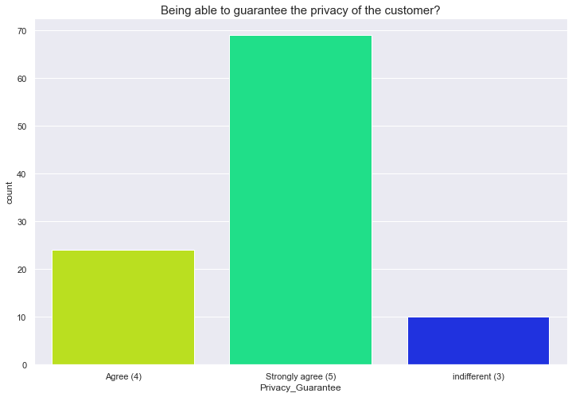
EDA (Exploratory Data Analysis)
The visualization in Fig.24 is a count plot from the sea-born library it clearly concludes that, customer privacy is a crucial factor. Customers should feel safe while shopping.
Fig.24

Slide 30
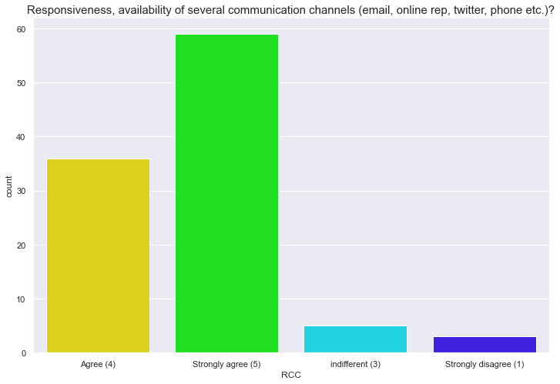
EDA (Exploratory Data Analysis)
The visualization in Fig.25 is a count plot from the sea-born library it clearly concludes that, the website should be responsive as users will use different devices to access the website. Having various channels for handling user queries is crucial.
Fig.25

Slide 31
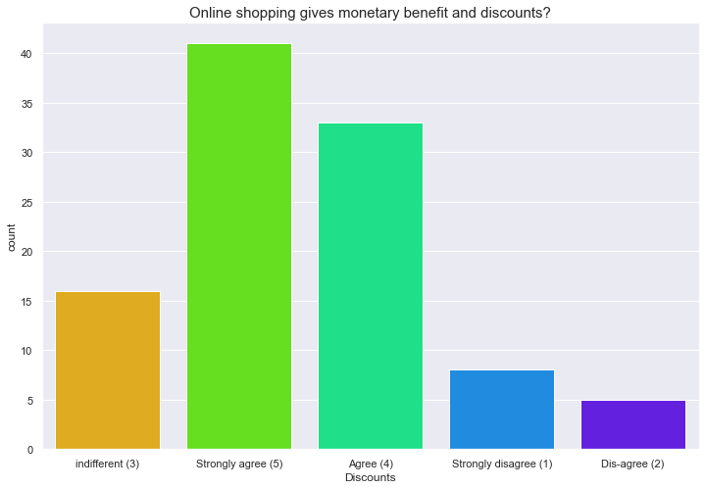
EDA (Exploratory Data Analysis)
The visualization in Fig.26 is a count plot from the sea-born library it clearly concludes that, monetary benefits and Discounts are influential to attract more customers in buying products online.
Fig.26

Slide 32
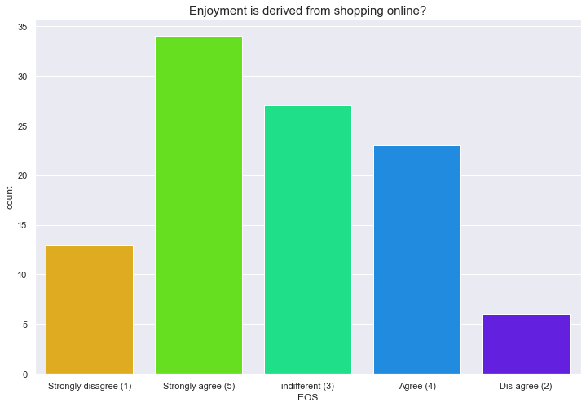
EDA (Exploratory Data Analysis)
The visualization in Fig.27 is a count plot from the sea-born library it clearly concludes that, most of the users enjoy the experience of online shopping.
Fig.27

Slide 33
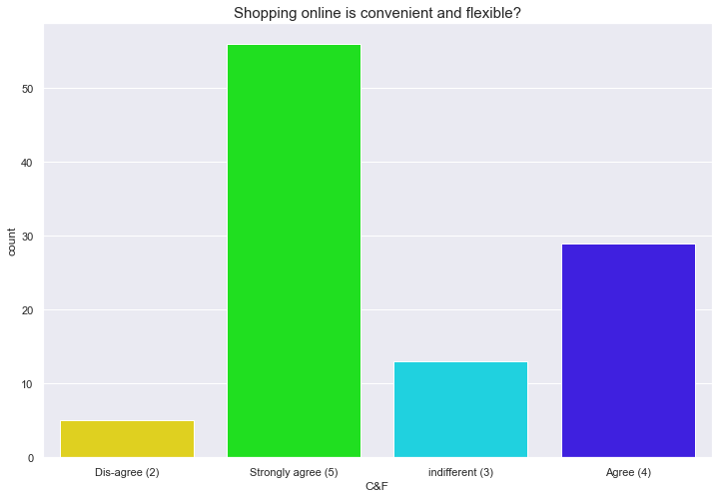
EDA (Exploratory Data Analysis)
The visualization in Fig.28 is a count plot from the sea-born library it clearly concludes that, highest number of customers believe that online shopping is convenient and flexible.
Fig.28

Slide 34
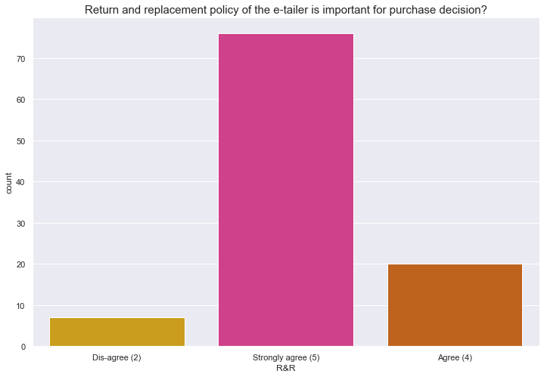
EDA (Exploratory Data Analysis)
The visualization in Fig.29 is a count plot from the sea-born library it clearly concludes that, In case the delivered product turns out to be faulty than in such cases return and replacement policy is very crucial.
Fig.29

Slide 35
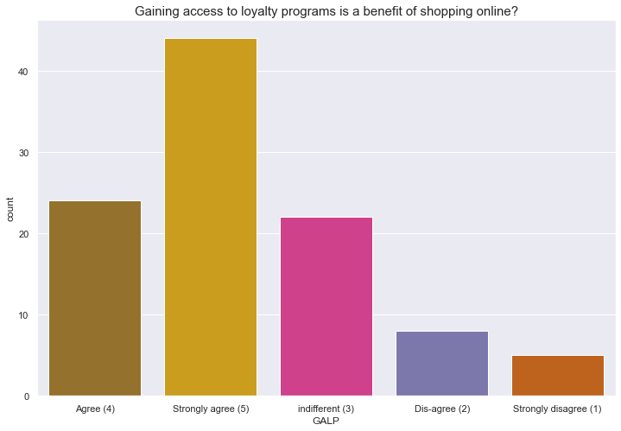
EDA (Exploratory Data Analysis)
The visualization in Fig.30 is a count plot from the sea-born library it clearly concludes that, service like this can enhance the experience for loyal customers.
Fig.30

Slide 36
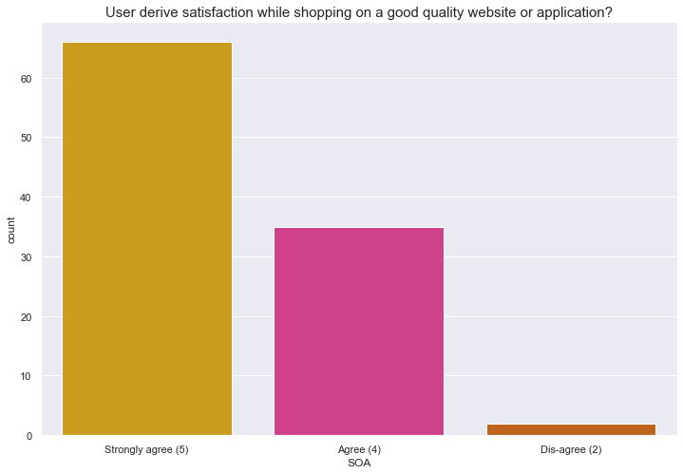
EDA (Exploratory Data Analysis)
The visualization in Fig.31 is a count plot from the sea-born library it clearly concludes that the website should be attractive, easy to navigate, and should have good customer support for users to be satisfied.
Fig.31

Slide 37
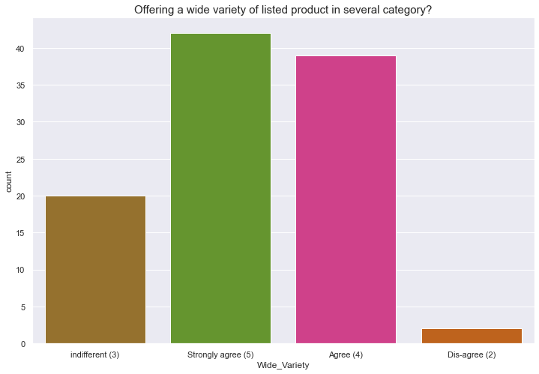
EDA (Exploratory Data Analysis)
The visualization in Fig.32 is a count plot from the sea-born library it clearly concludes that, when it comes to shopping has a lot of alternatives for products is crucial as it helps the customer to choose the best option.
Fig.32

Slide 38
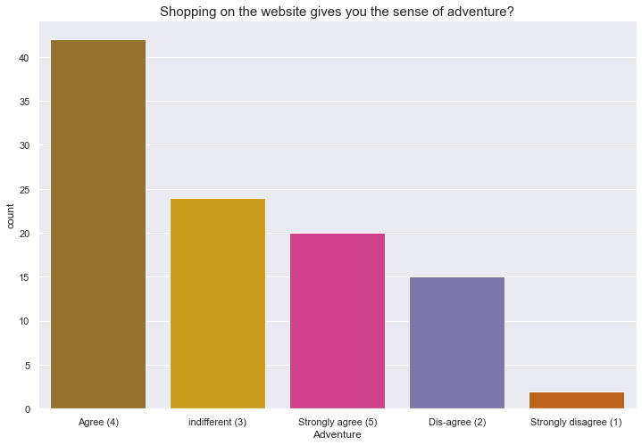
EDA (Exploratory Data Analysis)
The visualization in Fig.33 is a count plot from the sea-born library it clearly concludes that, most of the customers think that shopping online gives them a sense of adventure.
Fig.33

Slide 39
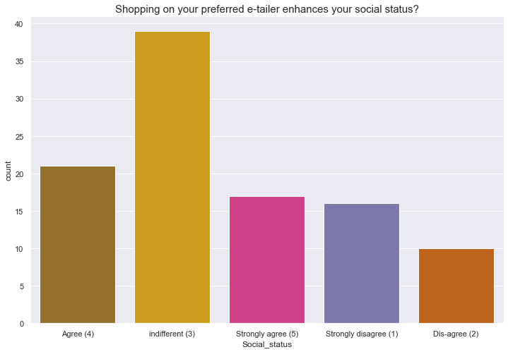
EDA (Exploratory Data Analysis)
The visualization in Fig.34 is a count plot from the sea-born library it clearly concludes that, according to most of the customers, there is no effect of online shopping on social status.
Fig.34

Slide 40
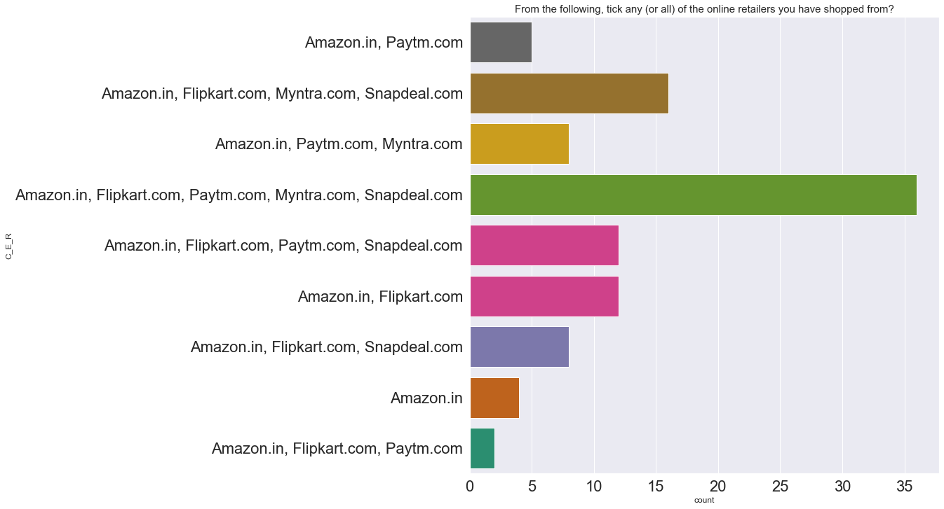
EDA (Exploratory Data Analysis)
Fig.35

Slide 41
EDA (Exploratory Data Analysis)
The visualization in Fig.35 is a count plot from the sea-born library it clearly concludes that, Most of the customers prefer Amazon. in, Flipkart.com, Paytm.com, Myntra.com, Snapdeal.com for shopping. we can say that these are the top 5 best e-commerce companies in India.

Slide 42
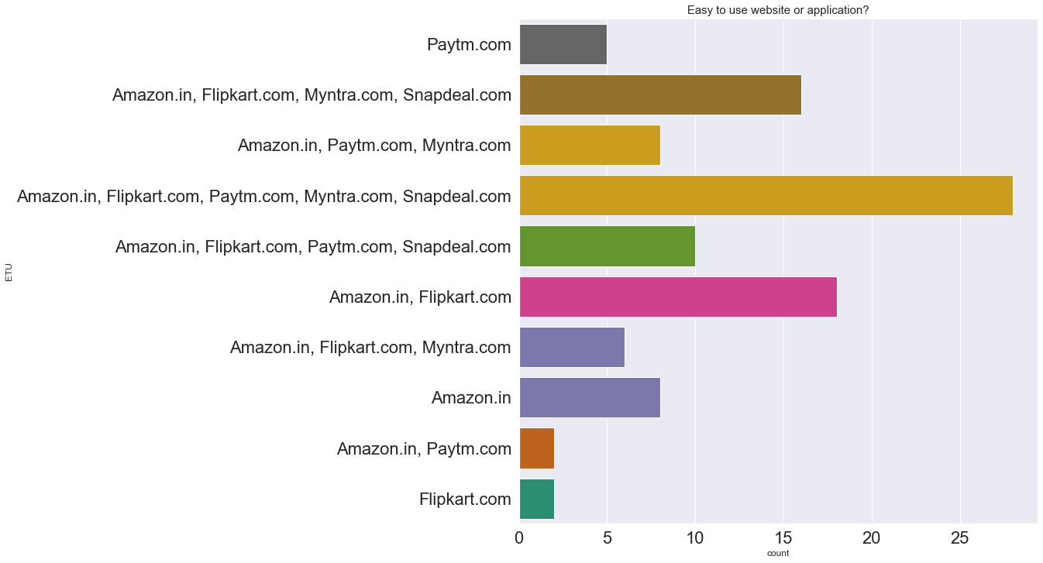
EDA (Exploratory Data Analysis)
Fig.36

Slide 43
EDA (Exploratory Data Analysis)
The visualization in Fig.36 is a count plot from the sea-born library it clearly concludes that, According to most of the customer's Amazon. in, Flipkart.com, Paytm.com, Myntra.com, Snapdeal.com are easy-to-use websites for online shopping.

Slide 44
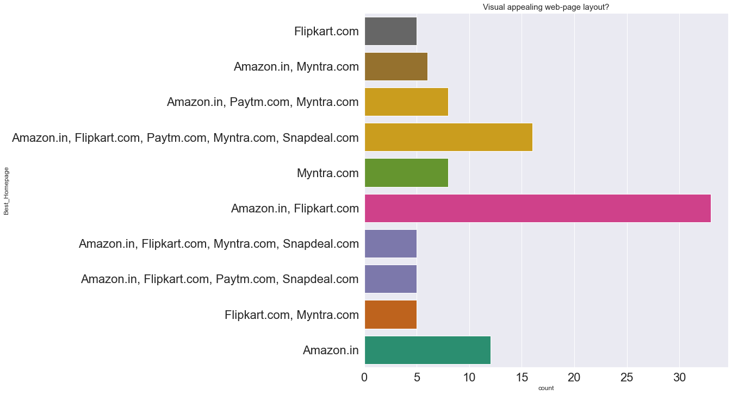
EDA (Exploratory Data Analysis)
Fig.37

Slide 45
EDA (Exploratory Data Analysis)
The visualization in Fig.37 is a count plot from the sea-born library it clearly concludes that, According to most of the customer's Amazon. in, Flipkart.com has the best home page in terms of design and user experience.

Slide 46
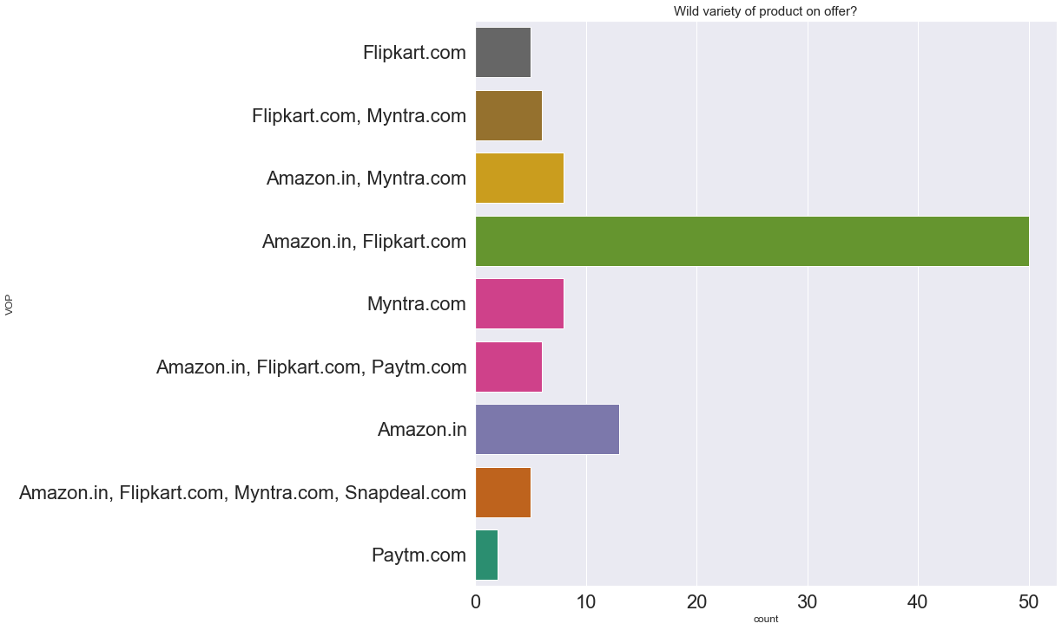
EDA (Exploratory Data Analysis)
Fig.38

Slide 47
EDA (Exploratory Data Analysis)
The visualization in Fig.38 is a count plot from the sea-born library it clearly concludes that, customers are voting for Amazon. in and Flipkart.com as the best e-commerce sites when it comes to the variety of products.

Slide 48
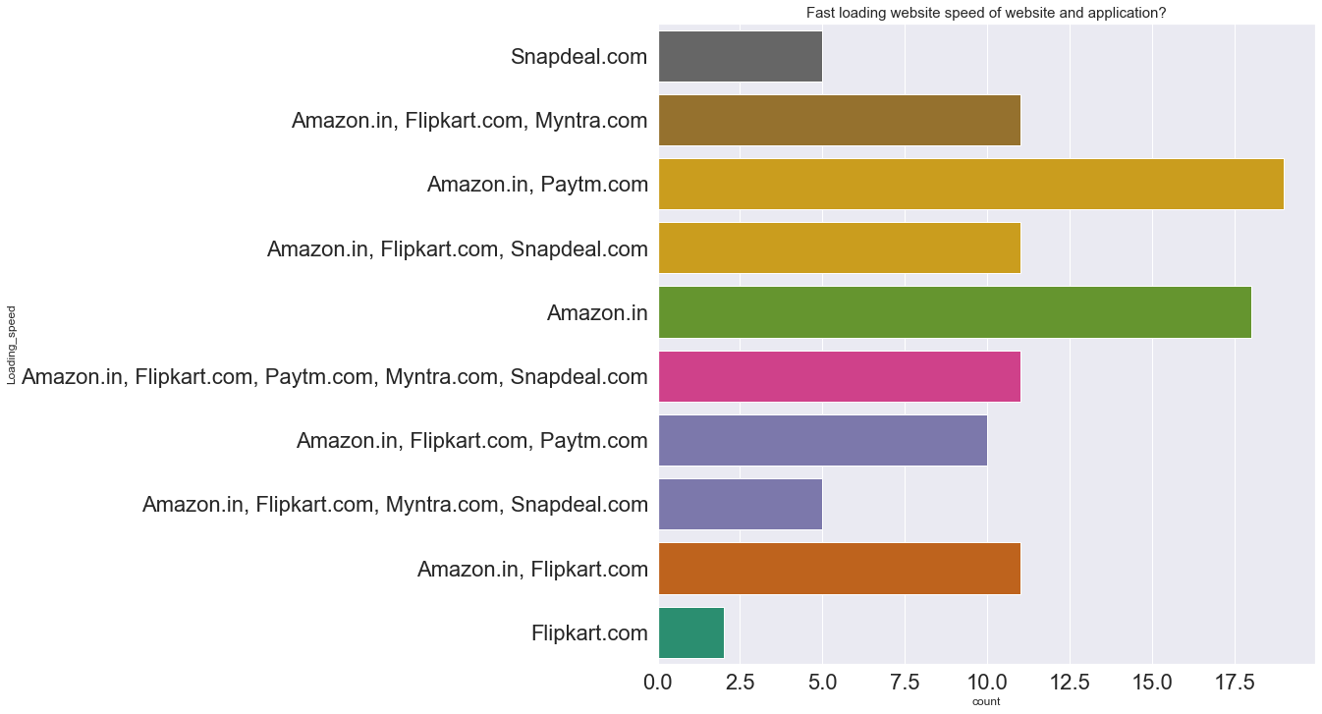
EDA (Exploratory Data Analysis)
Fig.39

Slide 49
EDA (Exploratory Data Analysis)
The visualization in Fig.39 is a count plot from the sea-born library it clearly concludes that, When it comes to loading speed Amazon. in, Paytm.com we voted as the fastest loading websites. According to this survey, Flipkart.com has a slower loading speed.

Slide 50
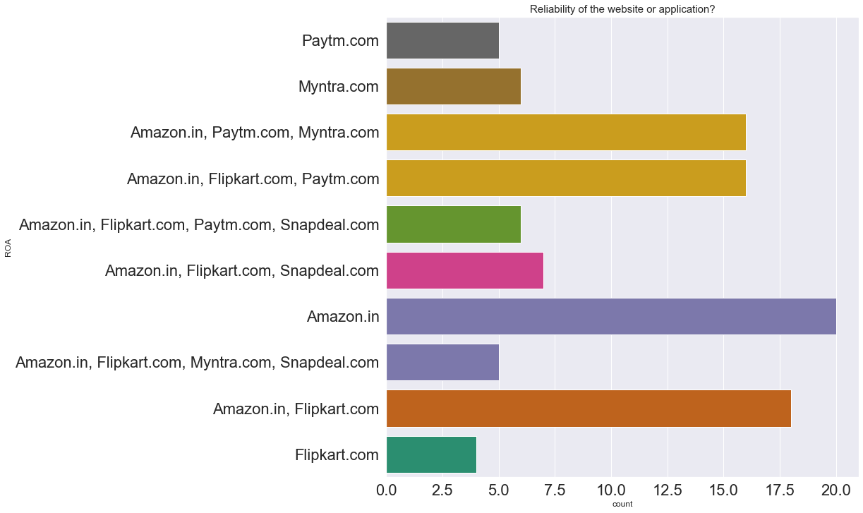
EDA (Exploratory Data Analysis)
Fig.40

Slide 51
EDA (Exploratory Data Analysis)
The visualization in Fig.40 is a count plot from the sea-born library it clearly concludes that, Amazon. in is the most reliable e Commerce website as compared to other online shopping websites.

Slide 52
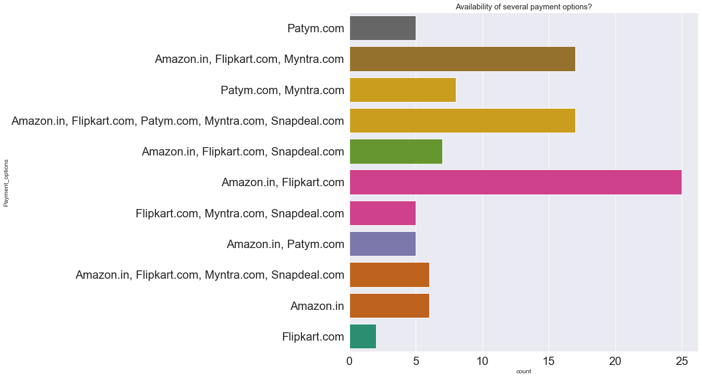
EDA (Exploratory Data Analysis)
Fig.41

Slide 53
EDA (Exploratory Data Analysis)
The visualization in Fig.41 is a count plot from the sea-born library it clearly concludes that, Amazon. in, Flipkart.com has the most number of payment alternatives.

Slide 54
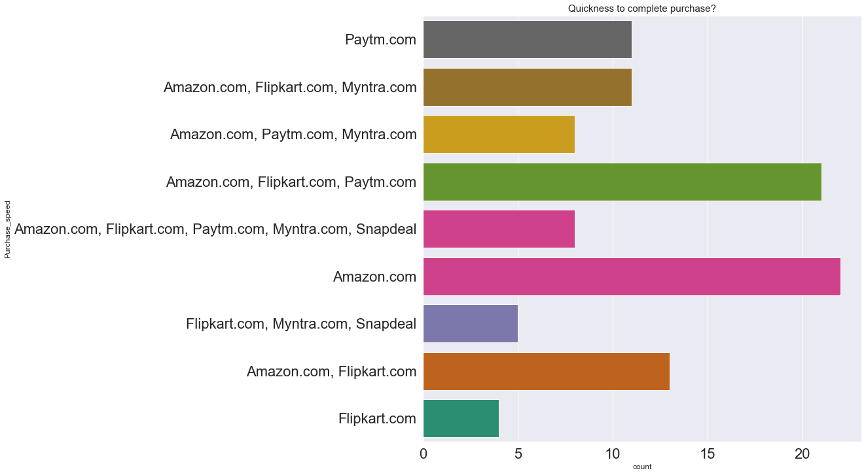
EDA (Exploratory Data Analysis)
Fig.42

Slide 55
EDA (Exploratory Data Analysis)
The visualization in Fig.42 is a count plot from the sea-born library it clearly concludes that, Amazon.in has the fastest purchase complete rate as compared to other websites.

Slide 56
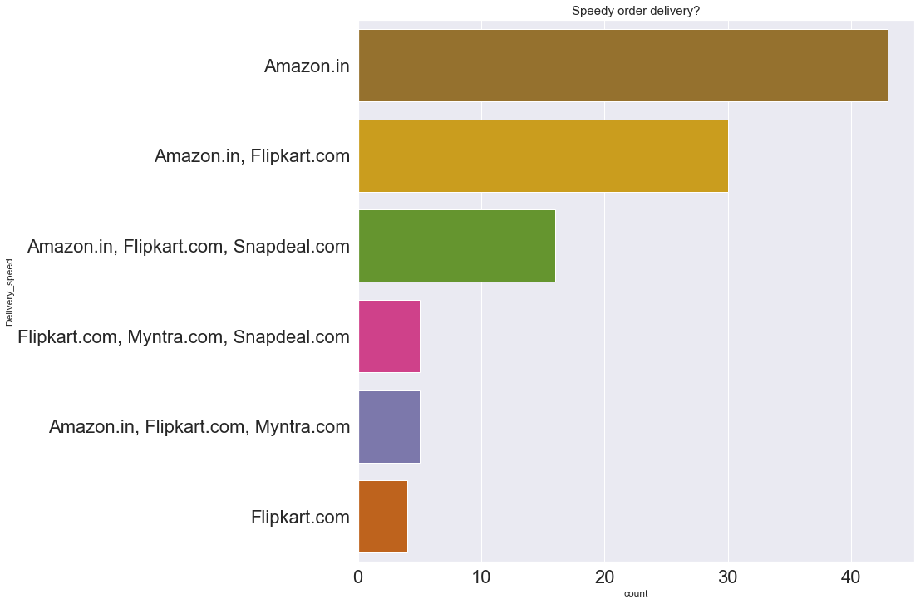
EDA (Exploratory Data Analysis)
Fig.43

Slide 57
EDA (Exploratory Data Analysis)
The visualization in Fig.43 is a count plot from the sea-born library it clearly concludes that, Amazon.com has the fastest delivery speed as compared to other e-commerce stores.

Slide 58
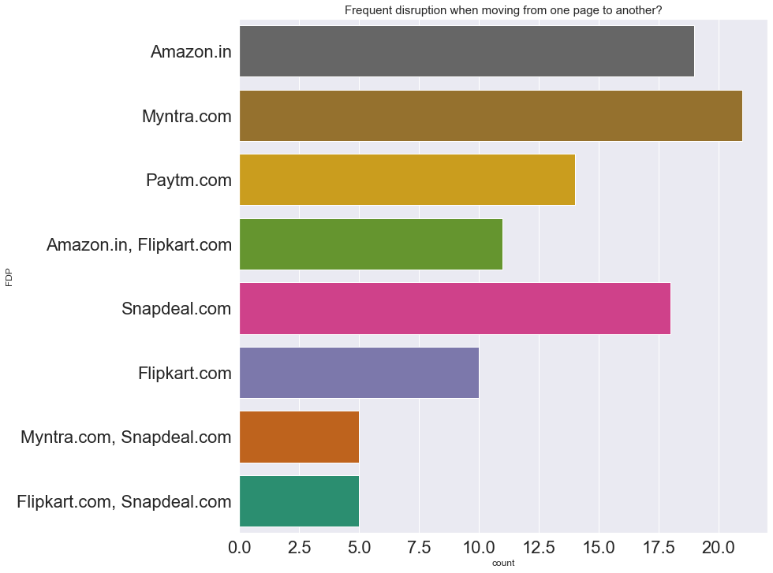
EDA (Exploratory Data Analysis)
Fig.44

Slide 59
EDA (Exploratory Data Analysis)
The visualization in Fig.44 is a count plot from the sea-born library it clearly concludes that, Myntra.com and Amazon.in have Frequent disruption when moving from one page to another.

Slide 60
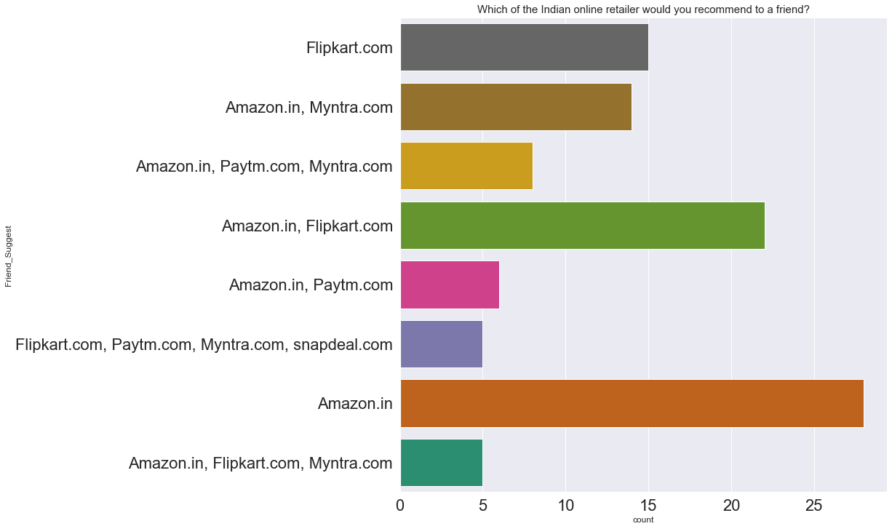
EDA (Exploratory Data Analysis)
Fig.45

Slide 61
EDA (Exploratory Data Analysis)
The visualization in Fig.45 is a count plot from the sea-born library it clearly concludes that, Amazon, Flipkart.com have the highest votes when making recommendations to a friend about Indian online retailers.

Slide 62
Concluding Remarks
For an online business to be successful emphasis must be given to the factors necessary for user satisfaction. However, these factors may differ among the customers as per their preferences.
From the above analysis we can conclude that Information, Trust and Service qualities prove to be the well-established factors necessary for online business users’ satisfaction.

Slide 63
Concluding Remarks
Some other factors like quality of system, information, accessibility, security, and ease of use are needed to appeal to the consumer’s utilitarian values.
On the other hand, to appeal to the hedonistic values of the consumer, the e-store should incorporate elements that would offer value to the pleasure seeking behaviour of customers; for example: adventure, gratification, role shopping etc.

Slide 64
Concluding Remarks
The result further suggests that customers’ perception of utilitarian and hedonistic values will inform their preference for a particular online store. Hence, attention to the customer specific content is very much important.

